Slide 1


Slide 2


Group No. 06
Nihara
Chamodya
Navodi
Gimhani

Slide 3








W hy we need this kind of system ?
W hat do we suggest?
W hat are the objectives ?
H ow we implemented it ?

Slide 4




W hy we need this kind of system ?

Slide 5



To identify vaccinated people

Slide 6
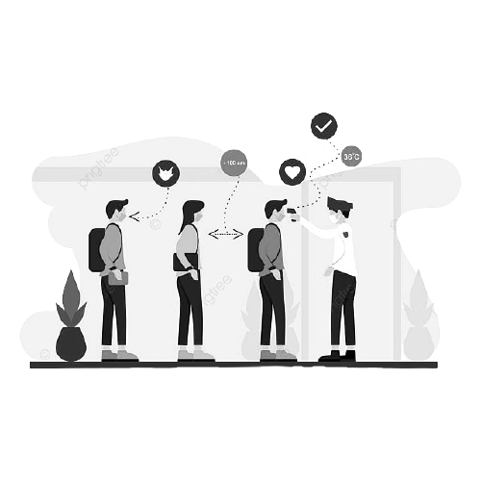

As a solution to a manual system

Slide 7




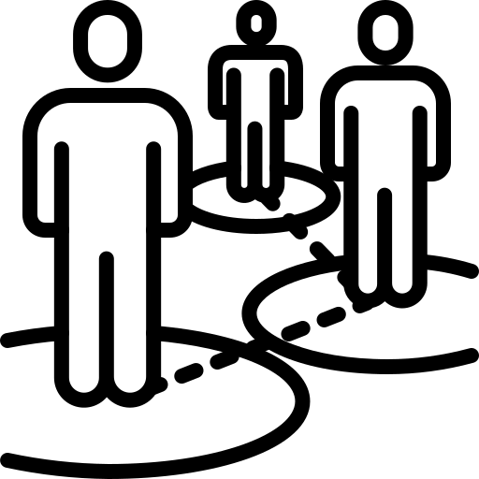
Reduce risk of spreading the virus

Slide 8




W hat do we suggest?
A Sub System
Recommended for which situations

Slide 9


As a Security System …
Only vaccinated people are allowed to let in.

Slide 10






Suitable for Which Situations ?

Slide 11


As a Sub System …

Slide 12



Matlab Software …
Interactive Graphics
Large library of mathematical functions
Data access and processing
Interactive Environment

Slide 13


Are you excited with this
System ?

Slide 14








W hat are the objectives ?

Slide 15
Efficiency
Accuracy
As a sub System
Safety

Slide 16

Efficiency

Slide 17

Accuracy

Slide 18
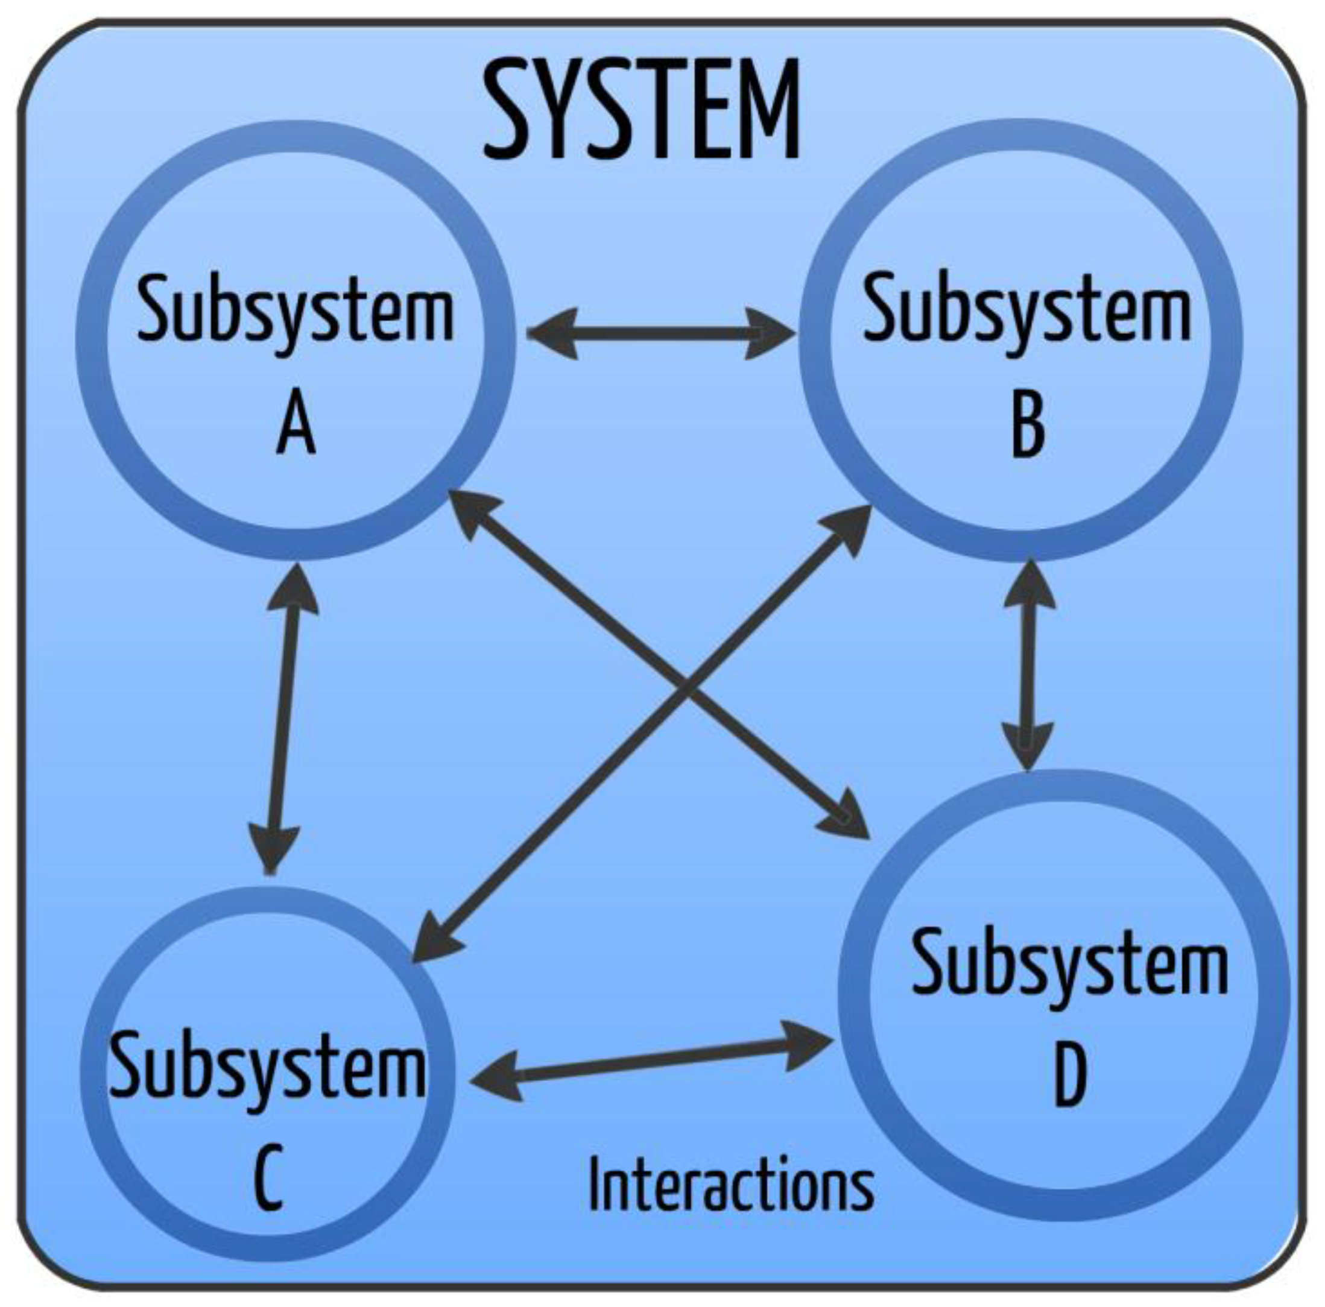
As a sub System

Slide 19

Safety

Slide 20
Let’s see how we
implement it

Slide 21
H ow we implemented it ?

Slide 22
H ow we implemented it ?
GUI
GUI
Codes
Codes
Final Product
Final Product

Slide 23

Let’s run
the program

Slide 24

GUI

Slide 25
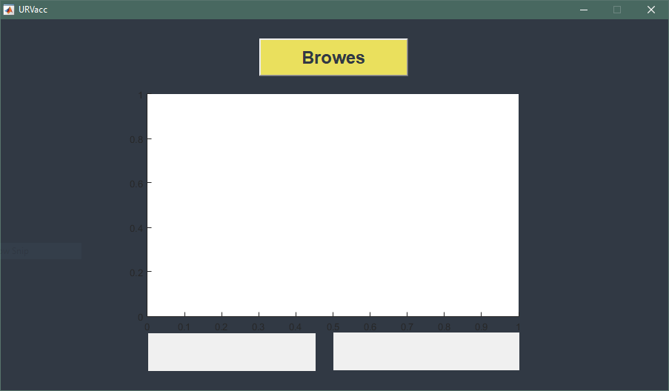
Button
Axes
Text
fields

Slide 26

Codes

Slide 27
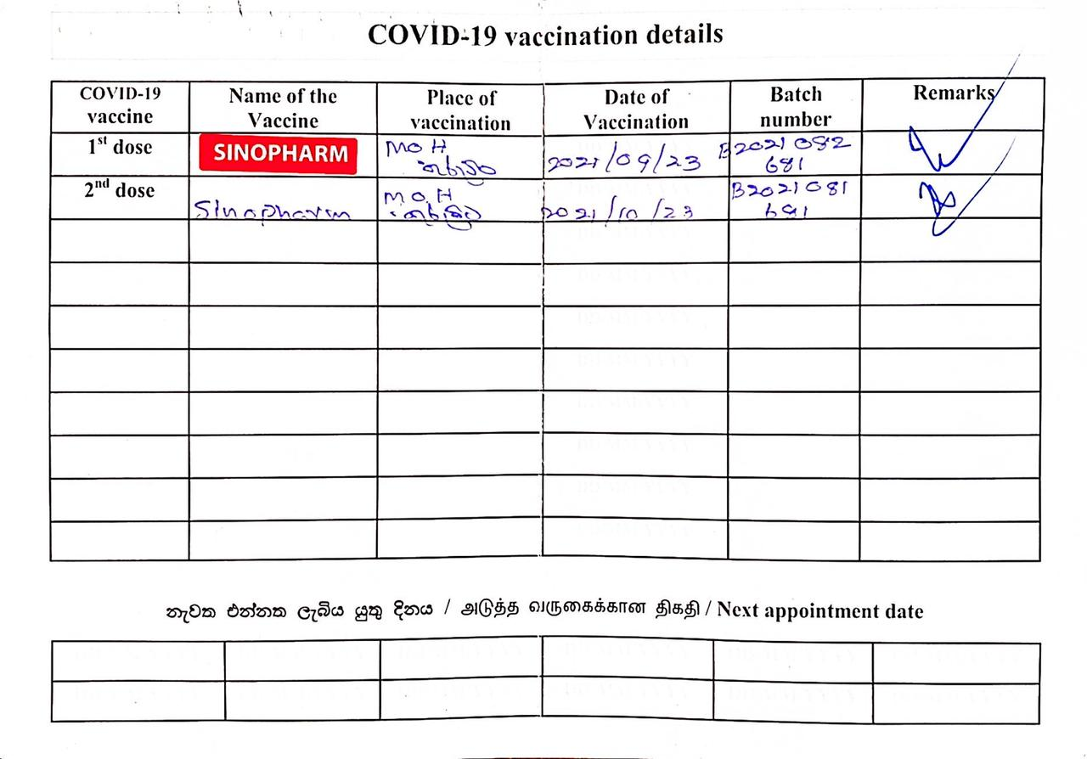
1
Scan the vaccine card

Slide 28
2
Resize the image

Slide 29
3
Crop image

Slide 30
3
Croped image

Slide 31
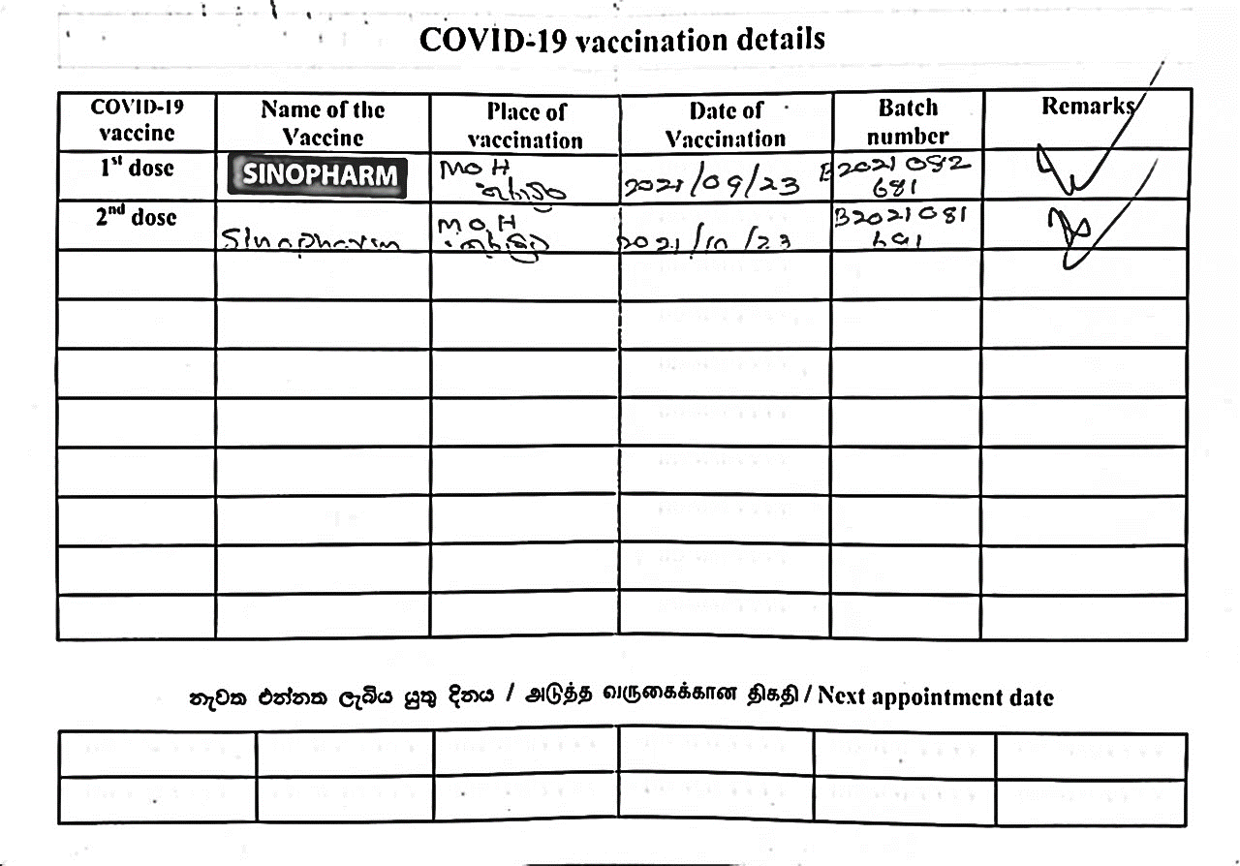
4
Convert to binary image

Slide 32

5
Read each row/column of pixels

Slide 33
5
Read each row/column of pixels

Slide 34
6
Capture table cells which contain with vaccine name

Slide 35
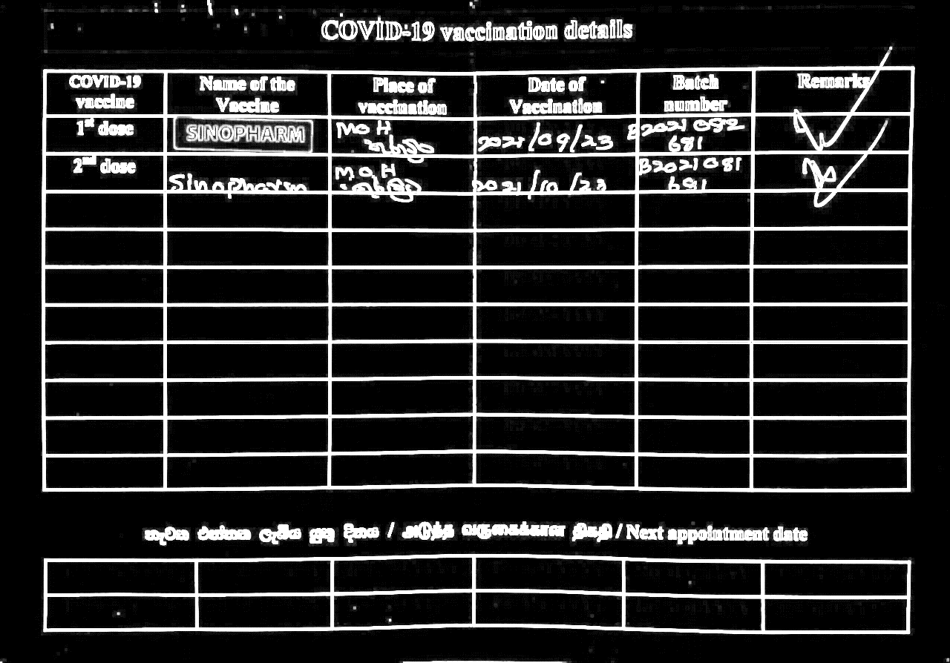
7
Use NOT operator

Slide 36
8
Count objects in each

Slide 37
9
Detect Color

Slide 38

Final Product

Slide 39
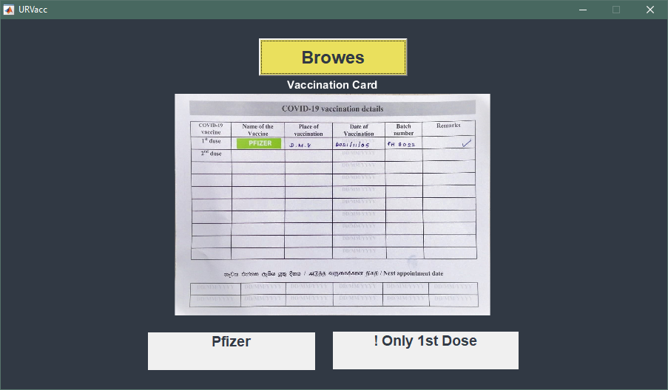

Slide 40


W e are ready to answer your questions ?

